Slide 1
Analyst Information Discovery and Interpretation Roles:
A Topic Modeling Approach
Jice Kunfeng Zheng
Allen H. Huang, Reuven Lehavy, Amy Y. Zang, Rong Zheng

Slide 2
Background
Corporate information(disclosures) → Analyst reports → Investors
Financial analysts play an intermediary role in capital markets.
Reports contain several quantitative summary measures, including earnings forecasts, stock recommendations, target prices, and textual discussion about the company
The textual discussion may cover a wide range of topics, such as the company’s current and future financial performance, recent corporate events, business strategies, management effectiveness, competitive landscape, and macroeconomic environment.

Slide 3
Introduction
How do financial analysts serve their information intermediary role by conducting a large-scale comparison of the textual content of analyst research reports to that of closely preceding corporate disclosures?
Compare the thematic content of a large sample of analyst reports issued on the day of and the day following quarterly earnings conference calls (hereafter, prompt reports) to that of managers’ narratives in these conference calls
Questions this paper investigates:
  What type of information do analysts provide in prompt reports?
  Do analyst discussions of new topics and of conference call topics provide incremental value to investors?
  Under what conditions do analyst reports provide more value to investors?

Slide 4
Two Roles of Analysts
Information Discovery – Analysts’ private efforts that generates new information
Field visit
  Supply chain investigation
  Private interaction with managers
  Information from other information intermediaries
  New information signals
Information Interpretation – Simplification or confirmation that help understand the disclosures
  Directions to relevant topics or what analysts view as being important
  Clarification on disclosure or assessment on subjective statements
  Opinions on issues raised
  Confirmation of the statement that enhances the reliability of the disclosure

Slide 5
Analyst Reports vs. Conference Calls-What’s new?
Topic modeling: extract meaningful topics from a large sample of analyst reports and conference calls
Approach: LDA

Slide 6
Latent Dirichlet Allocation(LDA)
In natural language processing, latent Dirichlet allocation (LDA) is a generative statistical model that allows sets of observations to be explained by unobserved groups that explain why some parts of the data are similar. For example, if observations are words collected into documents, it posits that each document is a mixture of a small number of topics and that each word's presence is attributable to one of the document's topics.
How do we do LDA?
  Create a collection of documents from news articles
  Each document represents a news article
  Clean data
    Convert every document to its atomic elements
    Remove useless words
    Merge words that have equivalent meaning

Slide 7
Latent Dirichlet Allocation(LDA)
Example:
There are two topics in total.
Doc 1: Basketball Soccer
Doc 2: Basketball Tennis
Doc 3: Cat Dog
Doc 4: Cat Bird
Generating topic distribution and word distribution
 | Topic 1(Sport) | Topic 2(Animal)
Basketball | 50% | 0
Soccer | 25% | 0
Tennis | 25% | 0
Cat | 0 | 50%
Dog | 0 | 25%
Bird | 0 | 25%
 | Topic 1(Sport) | Topic 2(Animal)
Doc 1 | 100% | 0
Doc 2 | 100% | 0
Doc 3 | 0 | 100%
Doc 4 | 0 | 100%

Slide 8
Latent Dirichlet Allocation(LDA)
 | Topic 1(Sport) | Topic 2(Animal)
Basketball | 50% | 0
Soccer | 25% | 0
Tennis | 25% | 0
Cat | 0 | 50%
Dog | 0 | 25%
Bird | 0 | 25%
If we have a new document, doc 5, we can make a prediction.
Doc 5: Basketball Cat Dog
Then Doc 5 is 33% of Topic 1 and 67% of Topic 2 according to our distribution.
 | Topic 1(Sport) | Topic 2(Animal)
Doc 1 | 100% | 0
Doc 2 | 100% | 0
Doc 3 | 0 | 100%
Doc 4 | 0 | 100%

Slide 9
Intuition of LDA in this paper
LDA assumes that a document is generated in two steps.
  First, a topic is randomly drawn based on the topic distribution of this document;
  Next, a word is randomly drawn based on the word distribution of the topic selected in the previous step.
  Repeating these two steps word by word generates a complete document. This basic idea of LDA simulates how a human writes a document: He/she has a plan to discuss certain topics first and then selects words to explain each topic.
Intuition: High probability topics are discussed more heavily in the document than low-probability topics, and a zero-probability topic is one that is not discussed in the document at all. Next, each topic is related to words probabilistically. High-probability words in a topic mean that they are more likely to appear in this topic.

Slide 10
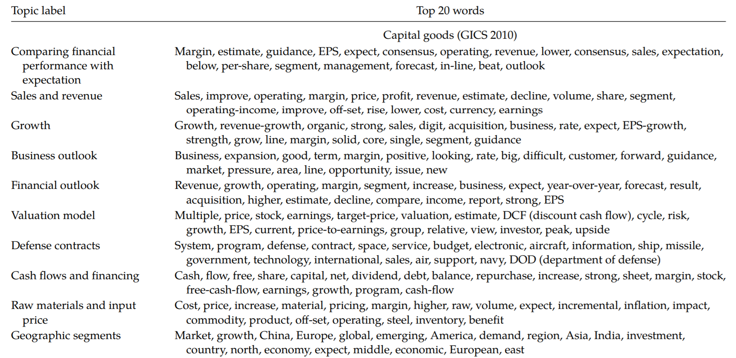
Example of High Probability Words in Capital Goods

Slide 11
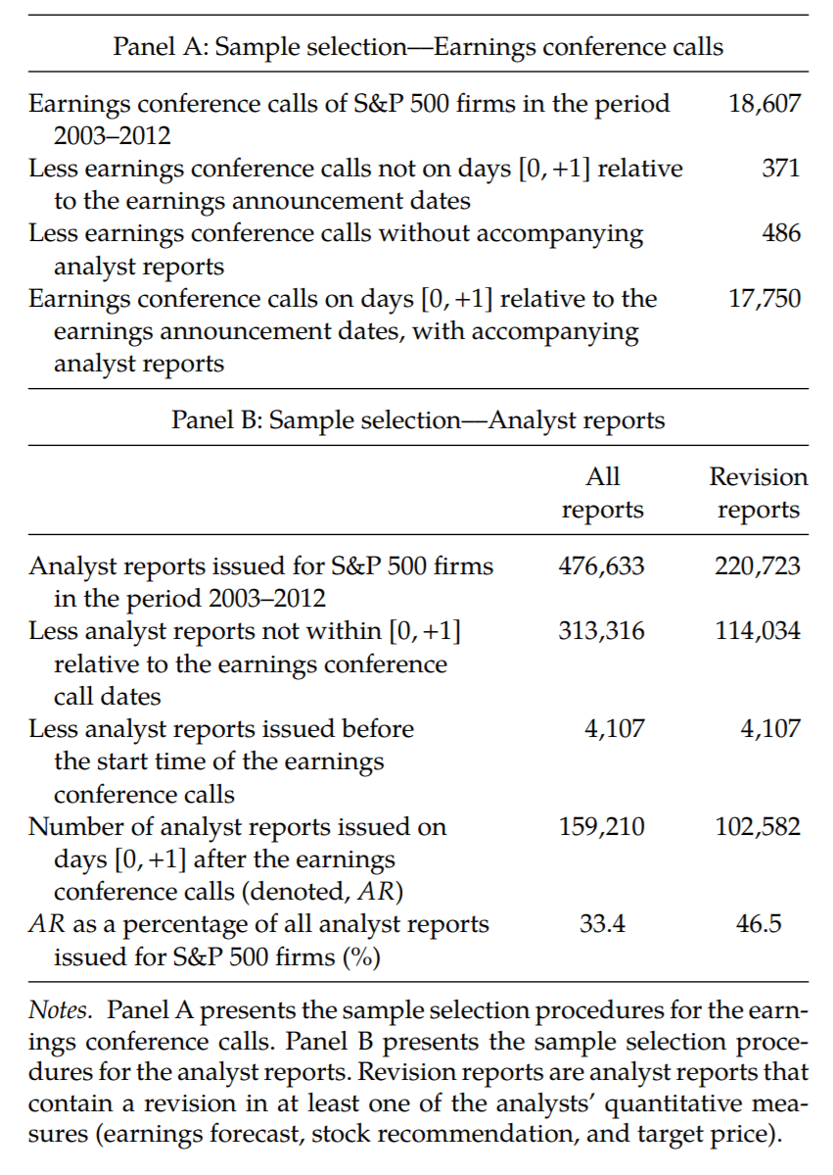
Sample
Selection

Slide 12
Comparison between Two LDA Results
Analyst Reports vs. Conference Calls
  Topic distribution
  Word distribution
Analysts spend approximately 31% on discovery and 69% on interpretation
But are these report valuable to investors?
  Efforts
  Expertise
  Knowledge of the firm and industry

Slide 13
Do Investors Value Analyst Information Discovery and Interpretation Roles?
Assessment by estimating the regression:
CAR[0, 1] = α₁Tone_Discovery+ β₁Tone_Interpret + γ₁Tone_CC +Controls+ ε
CAR[0, 1], the market reaction, is the cumulative market-adjusted return during [0, 1] relative to the earnings announcement dates.
Tone_Discovery: Labeled by LDA as not mentioned in conference calls
Tone_Interpret: Labeled by LDA as mentioned in conference calls

Slide 14
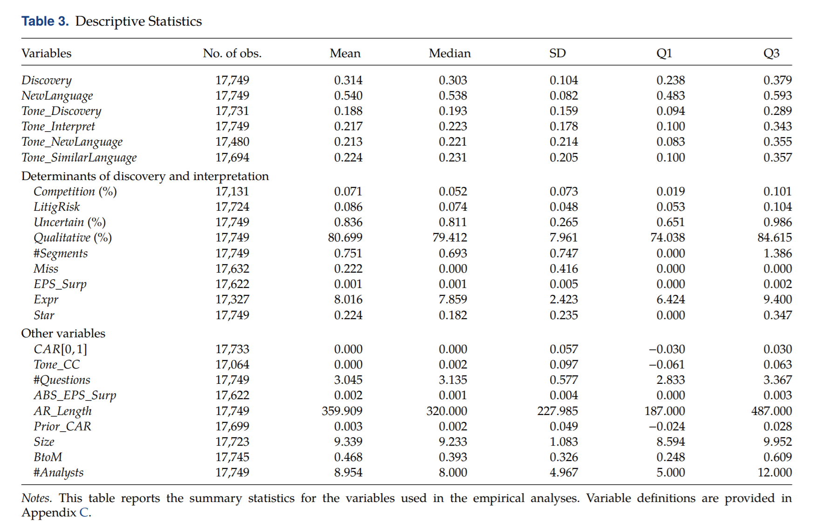
Do Investors Value Analyst Information Discovery and Interpretation Roles?

Slide 15
Do Investors Value Analyst Information Discovery and Interpretation Roles?
Tone_Discovery: 0.188
Tone_Interpret: 0.217
Tone_CC: 0.276
Positive numbers mean optimistic

Slide 16
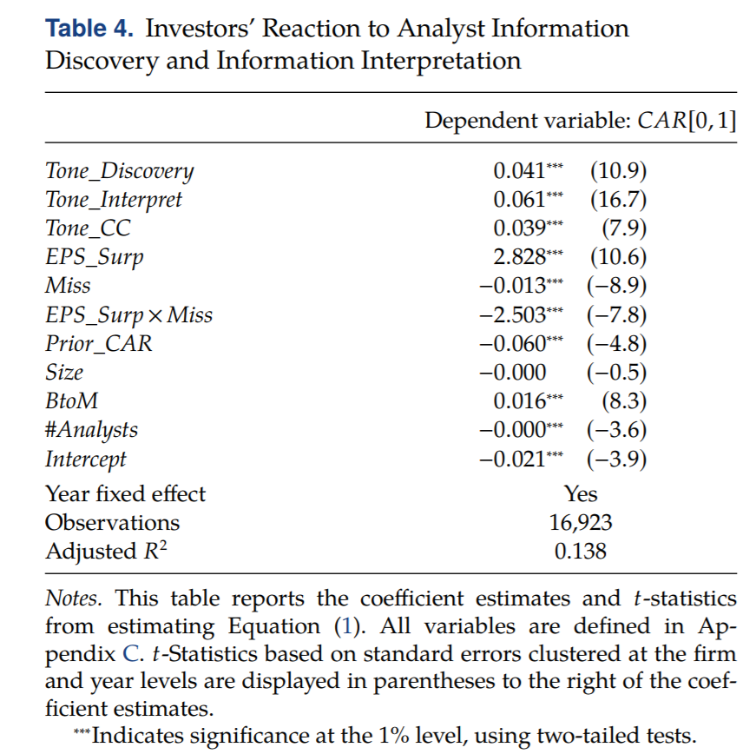
Do Investors Value Analyst Information Discovery and Interpretation Roles?
From the f-tests, investors value both interpretation and discovery, and they think interpretation immediately after earnings conference calls is more important.

Slide 17
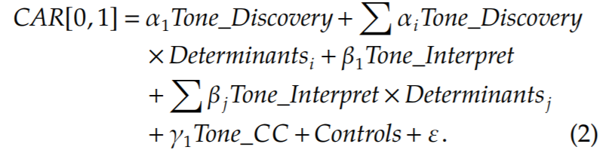
What Determines Investors’ Value of Analyst Information Discovery and Interpretation?
If managers withhold value-relevant information from investors, investors may place a greater value on the discovery.

Slide 18
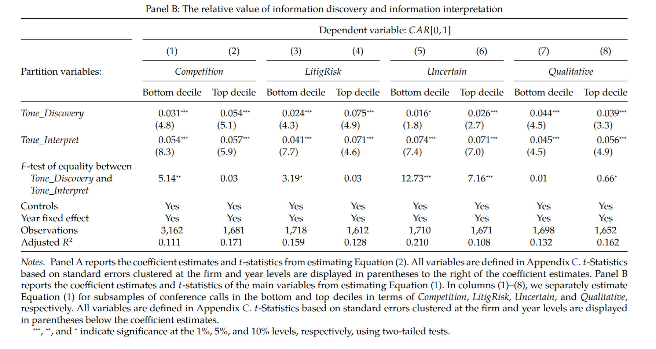
What Determines Investors’ Value of Analyst Information Discovery and Interpretation?
Competition: Percentage of competition-related words in CC in the firm’s previous conference call.
LitigRisk: The standard deviation of the monthly return of the firm in the 12 months prior to the conference call, winsorized at the top and bottom 1%.
Uncertain: The number of words in CC that are in the uncertainty word list created by Loughran and McDonald (2013), scaled by the total number of words in CC.
Qualitative: One minus the percentage of sentences that contain “$” or “%.”

Slide 19
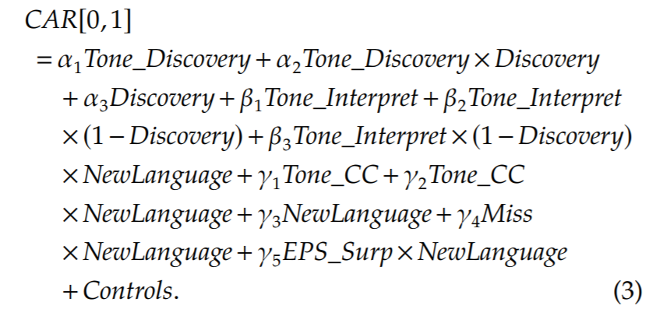
Do Investors Value Analysts’ Efforts?
Miss: An indicator variable that equals one if the actual EPS is less than the last consensus EPS forecast before the earnings announcement date and zero otherwise
EPS_Surp: Earnings surprise, calculated as the actual EPS minus the last consensus EPS forecast before the earnings announcement date
NewLanguage: The average of one minus within-topic cosine word similarity between CC and AR in the CC topics
Discovery: The number of sentences labeled by LDA as non-CC topics in AR scaled by the total number of sentences in AR

Slide 20
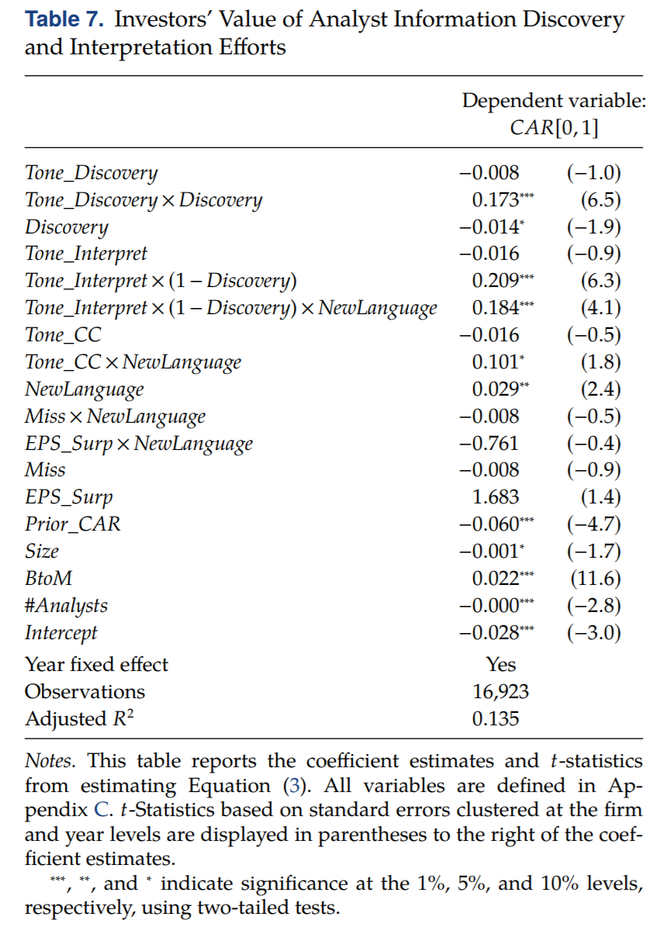
Do Investors Value Analysts’ Efforts?
Investors value analysts’ efforts expended on their information discovery and interpretation roles and that the market finds managers’ disclosures more informative when analysts spend more efforts to clarify these disclosures.

Slide 21
Does Analyst Confirmation Provide Value to Investors?
CAR[0, 1] = α₁Tone_Discovery+ β₁Tone_NewLanguage + β₂Tone_SimilarLanguage+ γ₁Tone_CC +Controls.
Tone_NewLanguage(Tone_SimilarLanguage): Tone_NewLanguage (Tone_SimilarLanguage) is the textual opinion of the sentences labeled by LDA as CC topics in AR using new (similar) language

Slide 22
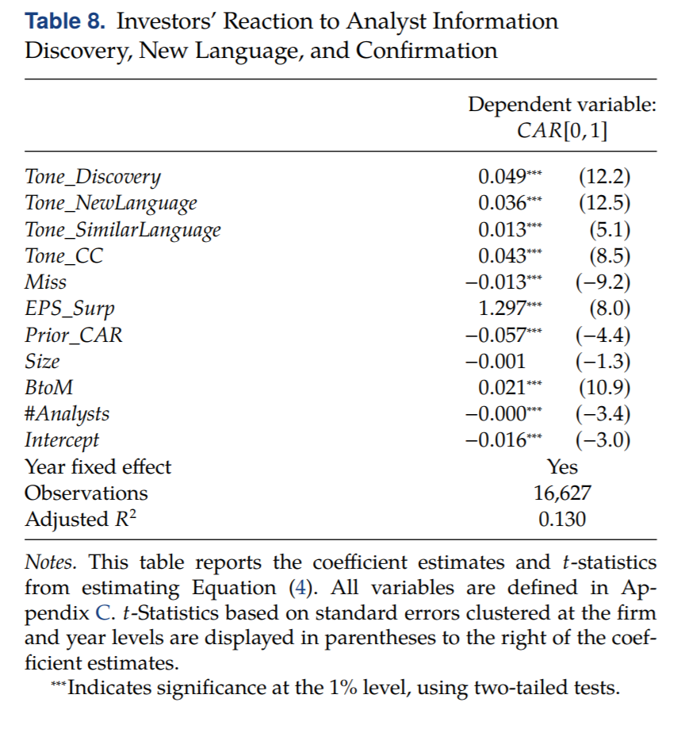
Does Analyst Confirmation Provide Value to Investors?
By selectively repeating CC topics, analysts attract and direct investors’ limited attention to what is important from managers— confirming these topics’ usefulness.
Moreover, repeating CC topics likely enhances the reliability of the statements of managers, who may suffer from agency problems, thus confirming these statements’ validity.
Confirming value

Slide 23
Conclusion
There are approximately 31% of an analyst prompt report serving an information discovery role and 69% an information interpretation role, and both roles trigger economically significant market reactions beyond the associated earnings news and conference call discussions, suggesting that analyst information roles provide value.

Slide 24
Reference
Analyst Information Discovery and Interpretation Roles: A Topic Modeling Approach, Allen H. Huang, Reuven Lehavy, Amy Y. Zang, Rong Zheng

